Slide 1

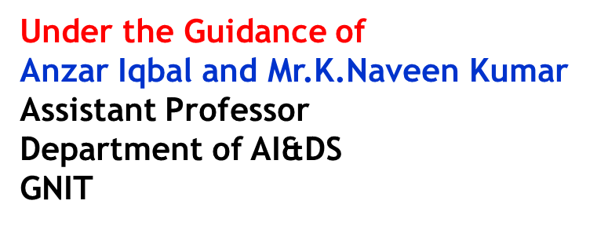

GURUNANAK INSTITUTE OF TECHNOLOGY HYDERABAD
(AUTONOMOUS)
ARTIFICIAL INTELLIGENCE AND DATA SCIENCE
A.Y.: 2023-2024
REAL TIME REASEARCH PROJECTS INTERNAL REVIEW
DIABETES PREDICTION APPLICATION
BATCH NO: 3
22831A72B4 S.RAMYA SRI
22831A72B8 T.LAHARI
22831A72B9 T.NAVADEEP
22831A72C1 U.UHA SRI
22831A72C2 U.VAISHNAVI
23835A7210 R.SAI TEJA

Slide 2
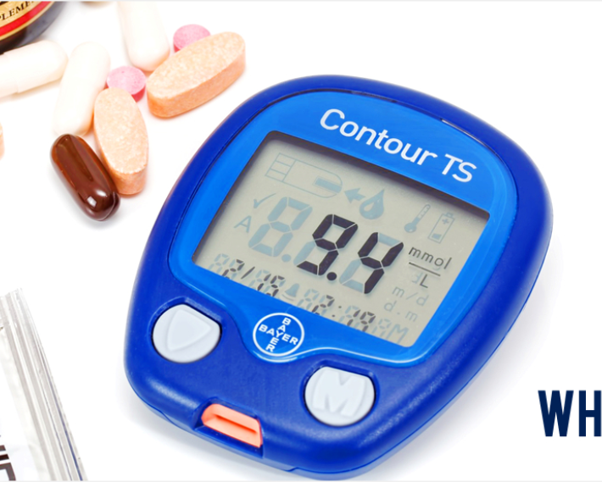
ABSTRACT
Diabetes mellitus is the most common disease worldwide and keeps increasing everyday due to changing lifestyles, unhealthy food habits and over weight problems. There were studies handled in predicting diabetes mellitus through physical and chemical tests, are available for diagnosing diabetes. Data science methods have the potential to benefit other scientific fields by shedding new light on common questions. The experiment results shows that the prediction of diabetes done at high accuracy

Slide 3
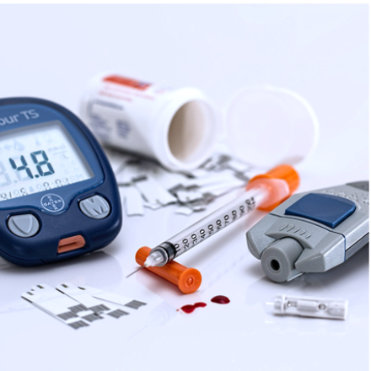
introduction
Diabetes, often referred to as "diabetes mellitus," encompasses a group of metabolic disorders characterized by high blood sugar levels over a prolonged period. It results from either inadequate insulin production by the pancreas or the body's cells not responding effectively to insulin, or both. There are several types of diabetes, with the most common being Type 1, Type 2, and gestational diabetes.

Slide 4
SYMPTOMS OF DIABETes
Frequent Urination (Polyuria): One of the early symptoms of diabetes is frequent urination. Excess sugar in the blood draws water from tissues, leading to increased urination.
Increased Thirst (Polydipsia): As a result of frequent urination, individuals with diabetes may experience increased thirst. The body tries to replenish lost fluids by triggering thirst signals.
Unexplained Weight Loss: Despite increased hunger and eating, people with undiagnosed diabetes may experience unexplained weight loss. This occurs because the body is unable to properly use glucose for energy, so it starts burning fat and muscle for fuel.

Slide 5
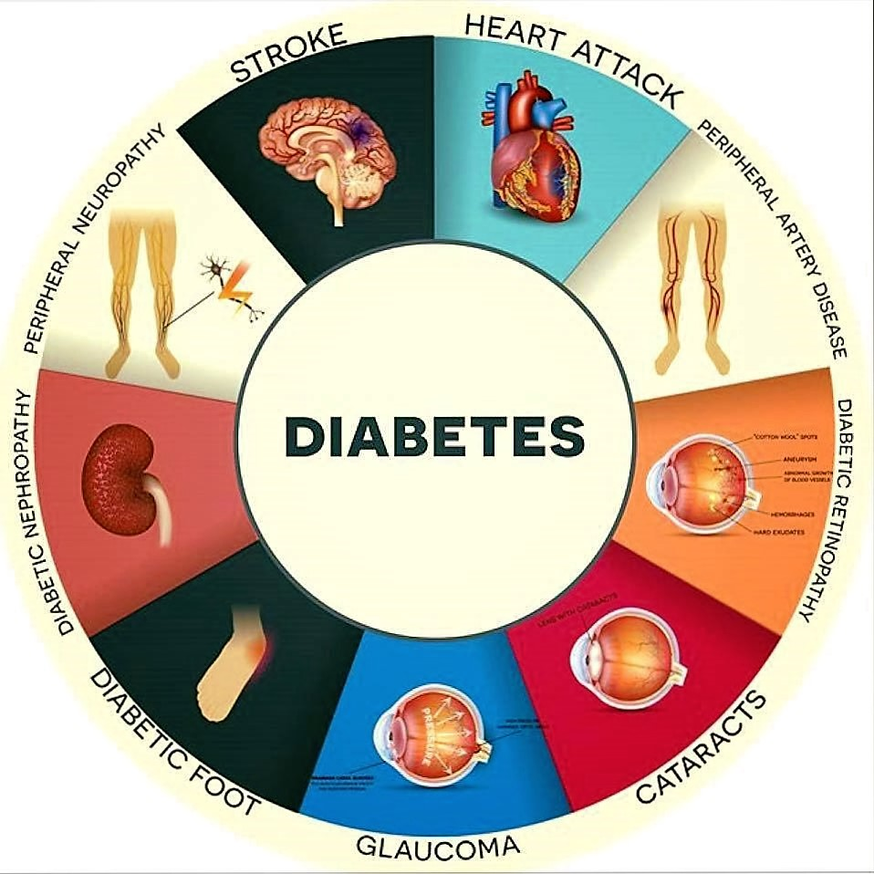
PREVENTIOn oF DIABETes
Healthy Diet and Weight Management: Adopting a balanced diet that is low in refined sugars, saturated fats, and processed foods can help prevent the onset of diabetes. Emphasize whole grains, fruits, vegetables, lean proteins, and healthy fats. Additionally, maintaining a healthy weight through regular physical activity can significantly reduce the risk of developing type 2 diabetes. Even small amounts of weight loss, such as 5-10% of total body weight, can have a substantial impact on reducing diabetes risk.
This Photo by Unknown Author is licensed under CC BY-NC-ND

Slide 6
existing system
Predicting diabetes is crucial for early intervention and management of the condition. Existing systems for diabetes prediction typically involve the use of machine learning algorithms trained on medical data to identify patterns indicative of diabetes or pre-diabetic conditions. These systems often utilize features such as blood glucose levels, BMI, age, family history, diet, exercise habits, and other relevant medical data to make predictions.
Existing many research handled for diabetes detection. Data mining approach like clustering, classification were studied in existing system

Slide 7
disadvantages
Psychological Burden: Diabetic prediction can lead to increased anxiety and stress in individuals who are identified as at risk for developing diabetes. Knowing that they are predisposed to a chronic condition can cause psychological distress and impact their overall well-being. False Positives/Negatives: Diabetic prediction models may sometimes yield false positive or false negative results, leading to either unnecessary worry or a false sense of security. False positives can lead to unnecessary interventions and lifestyle modifications, while false negatives may delay necessary preventive measures and early interventions.

Slide 8
Proposed system
Gather relevant data from individuals including demographic information (age, gender), medical history (family history of diabetes, previous diagnoses), lifestyle factors (diet, exercise habits), and clinical measurements (blood glucose levels, blood pressure, BMI).
Apply feature extraction techniques to identify the most significant features that correlate with diabetes risk. This may involve statistical analysis and machine learning methods like principal component analysis (PCA) or feature importance ranking.

Slide 9
ADVANTAGES
Early Intervention: Predicting diabetes before it fully manifests allows individuals to make lifestyle changes such as diet modifications, exercise routines, and stress management techniques, which can help delay or even prevent the onset of the disease.
Healthcare Resource Allocation: Healthcare systems can allocate resources more efficiently by identifying individuals at high risk of diabetes. This can include targeted screening programs and interventions for high-risk groups, reducing the burden on healthcare services in the long term.

Slide 10
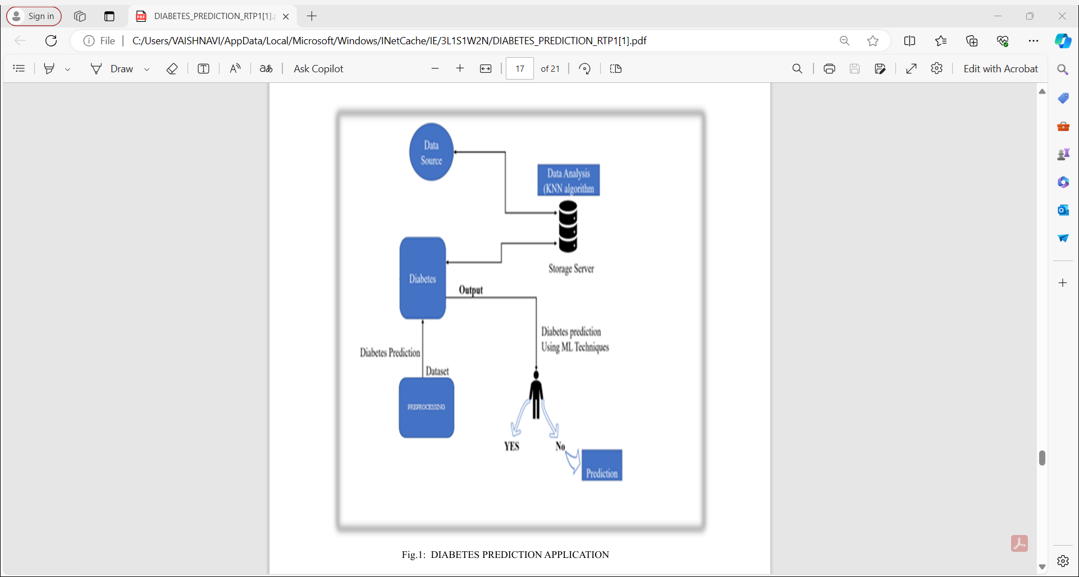
Architecture and design

Slide 11
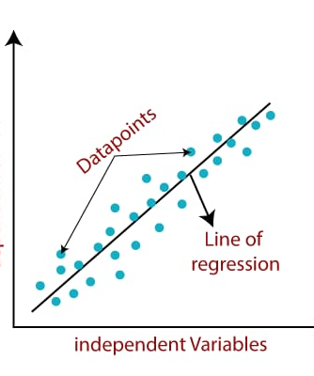
Linear Regression
Linear regression is a supervised learning algorithm which is used for prediction problems.It is a method to predict the target variable by finding a best fit line between the independent and dependent variable. The best fit is the line with minimum error from all the points.Least square method:The best fit is calculated by making sure that the sum of all the distances between the shape and the actual observations at each point is as small as possible

Slide 12
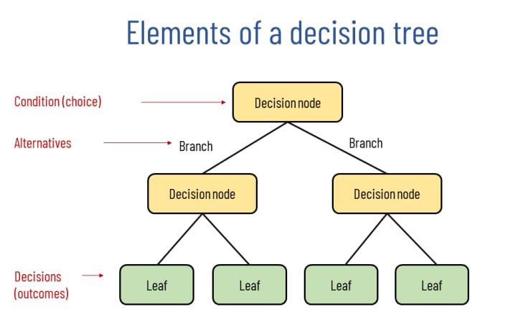
Decision Trees
Decision Trees are supervised learning method used for classification and regression. The goal is to create a model that predicts the value of a target variable by learning simple decision rules inferred from the data features.

Slide 13
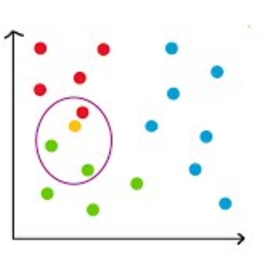
KNN
KNN is the simplest machine learing algorithm that is used for classification problemacsupervised learning) Whenever the model is fed with a testing data it finds the distance of that point with every other point in the training data. Then it finds nearest k members for that point This helps us to classify the data into a particular group The value of k gives us the number of nearest neighbours ts consider while classifying the new data pont

Slide 14
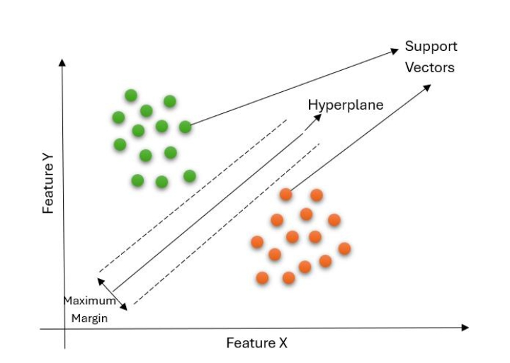
SVM
Support Vector Machine is a supervised machine learning algorithm which can be used for both classification and regression problems. The goal of SVM is to find the hyperplane which divides the two classes of data.Generally SVM is used to classify the data(supervised leaming). A hyperplane which divides two classes with maximum distances is called as optimal hyperplane Support vectors are those coordinates which are at minimum distance from the optimal hyperplane

Slide 15
Naive Bayes
Naive hoyen in a supervised machine learning algorithm which is used to classify data into predefined classes.
It uses the concept of conditional probability to classify the test data
Conditional Probability: It helps us to find the probability that something will happen given that something else has happened
Consider two events A and B, then P(A and B)=P(A)+P(B|A)Note that P(B|A) is probability that 8 happens given that A has already happened.

Slide 16
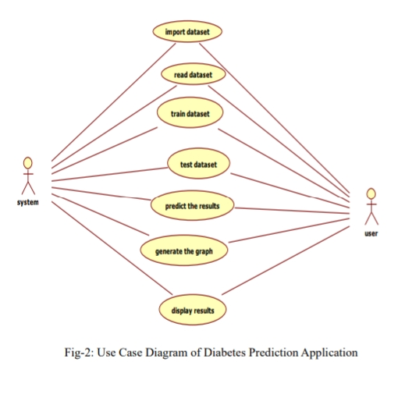
UML DIAGRAMs
USE CASE DIAGRAMS

Slide 17
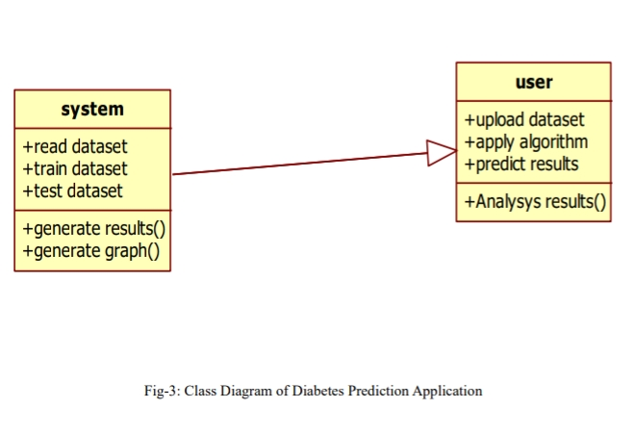
Class diagram

Slide 18
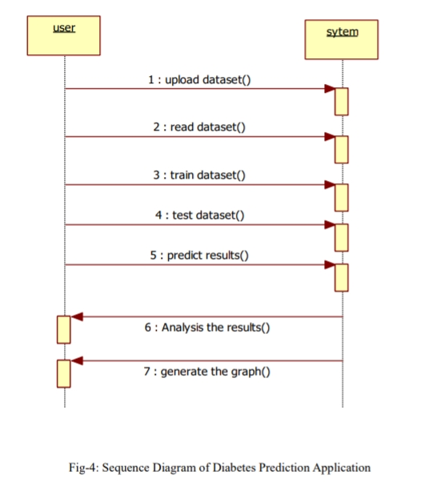
sequential

Slide 19
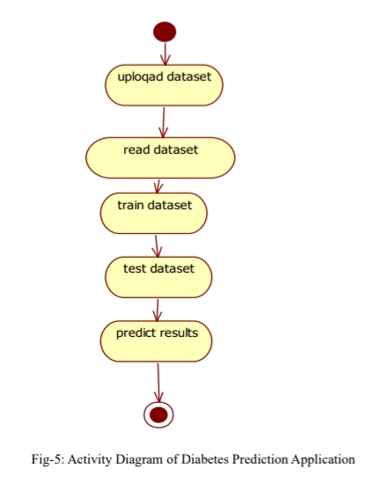
Activity

Slide 20
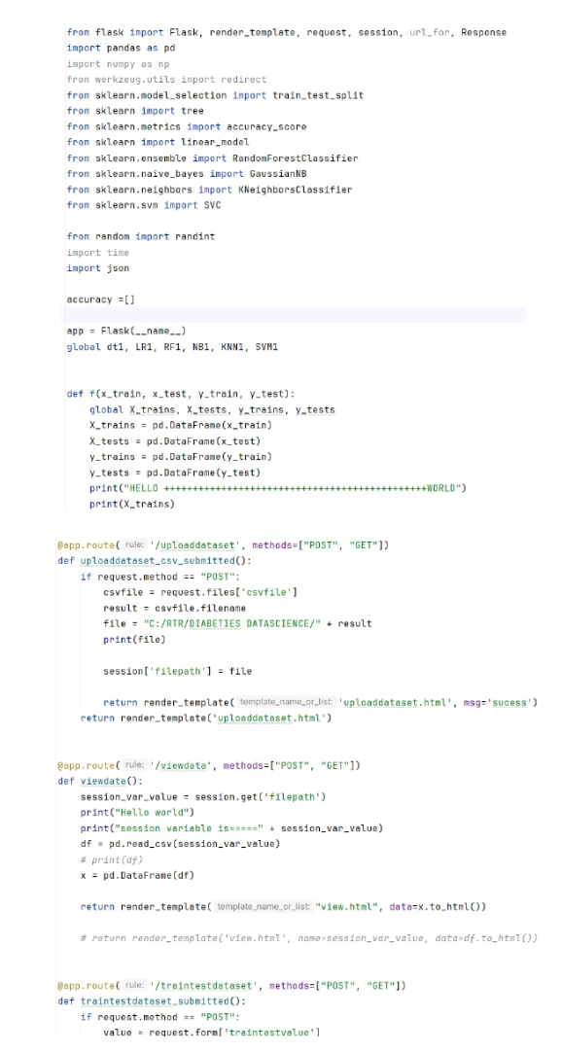
Implementation

Slide 21
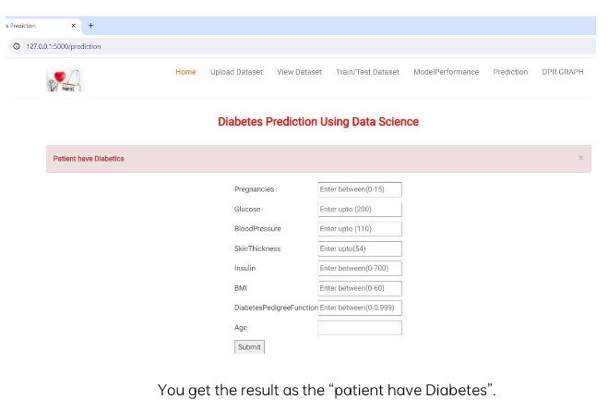
Results
Here is the graph for the data set taken. The gives the information about which algorithm is predicting the highest accuracy for the taken data set. Form the above graph we can say Accuracy for the taken data set is “79”. Algorithm predicting the highest accuracy is “Logistic Regression”.

Slide 22
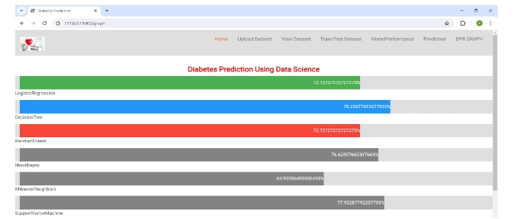
GRAPH
The beside graph describes which machine learning algorithm gives the highest accuracy.Accuracy for the taken data set is “79”.The algorithm predicting the highest accuracy is “Logistic Regression”

Slide 23
System and software requirements
HARDWARE REQUIREMENTS:
System : Pentium Dual Core
Hard Disk : 120 GB
Monitor : 15’’ LED
Input Devices : Keyboard, Mouse
Ram : 4GB
SOFTWARE REQUIREMENTS:
Operating system : Windows 7/10
Coding Language : Python
Tool : Python 3.6.

Slide 24
CONCLUSION
In our research, firstly, we have adopted several machine learning algorithms and evaluated their performances to predict the diabetes of individuals. Secondly, we have conducted several experiments and evaluated the performance of the proposal. We found that SVM outperforms the other algorithms. Finally, based on our observed results, a smart web application is developed for predicting diabetes accordingly. Any individual can submit clinical data to this web application, which can then forecast the existence or absence of diabetes. Individuals who are unsure or simply want a routine checkup may consider this application. Our model is compared with two recent studies, and the findings reveal that, depending on the dataset and the ML method used, the suggested model can offer greater accuracy ranging from 2.71% to 13.13%. While we have conducted several experiments utilizing two distinct datasets, this study still has room for additional research and development using a variety of deep learning methods.

Slide 25
REFERENCES
  ADA (American Diabetes Association):
    The ADA provides guidelines and resources for the diagnosis and prediction of diabetes. Their website and publications often include the latest research and recommendations in this area.
  Clinical Guidelines:
    Clinical guidelines, such as those from the American Association of Clinical Endocrinologists (AACE) and the American College of Endocrinology (ACE), offer insights into risk assessment and predictive models for diabetes.

Slide 26
Thank you

